Slide 1

MATLAB Fundamentals

Slide 2

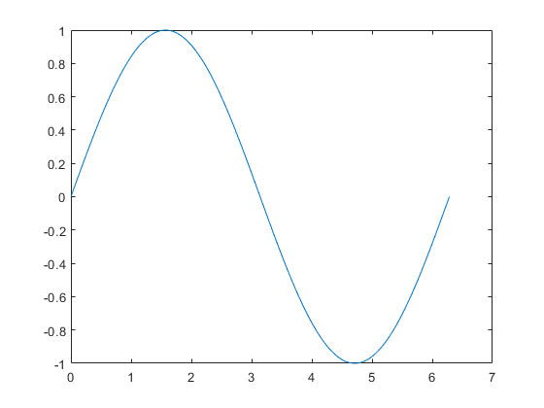

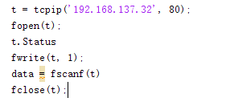
Introduction
Computation
Visualization
Programming

Slide 3
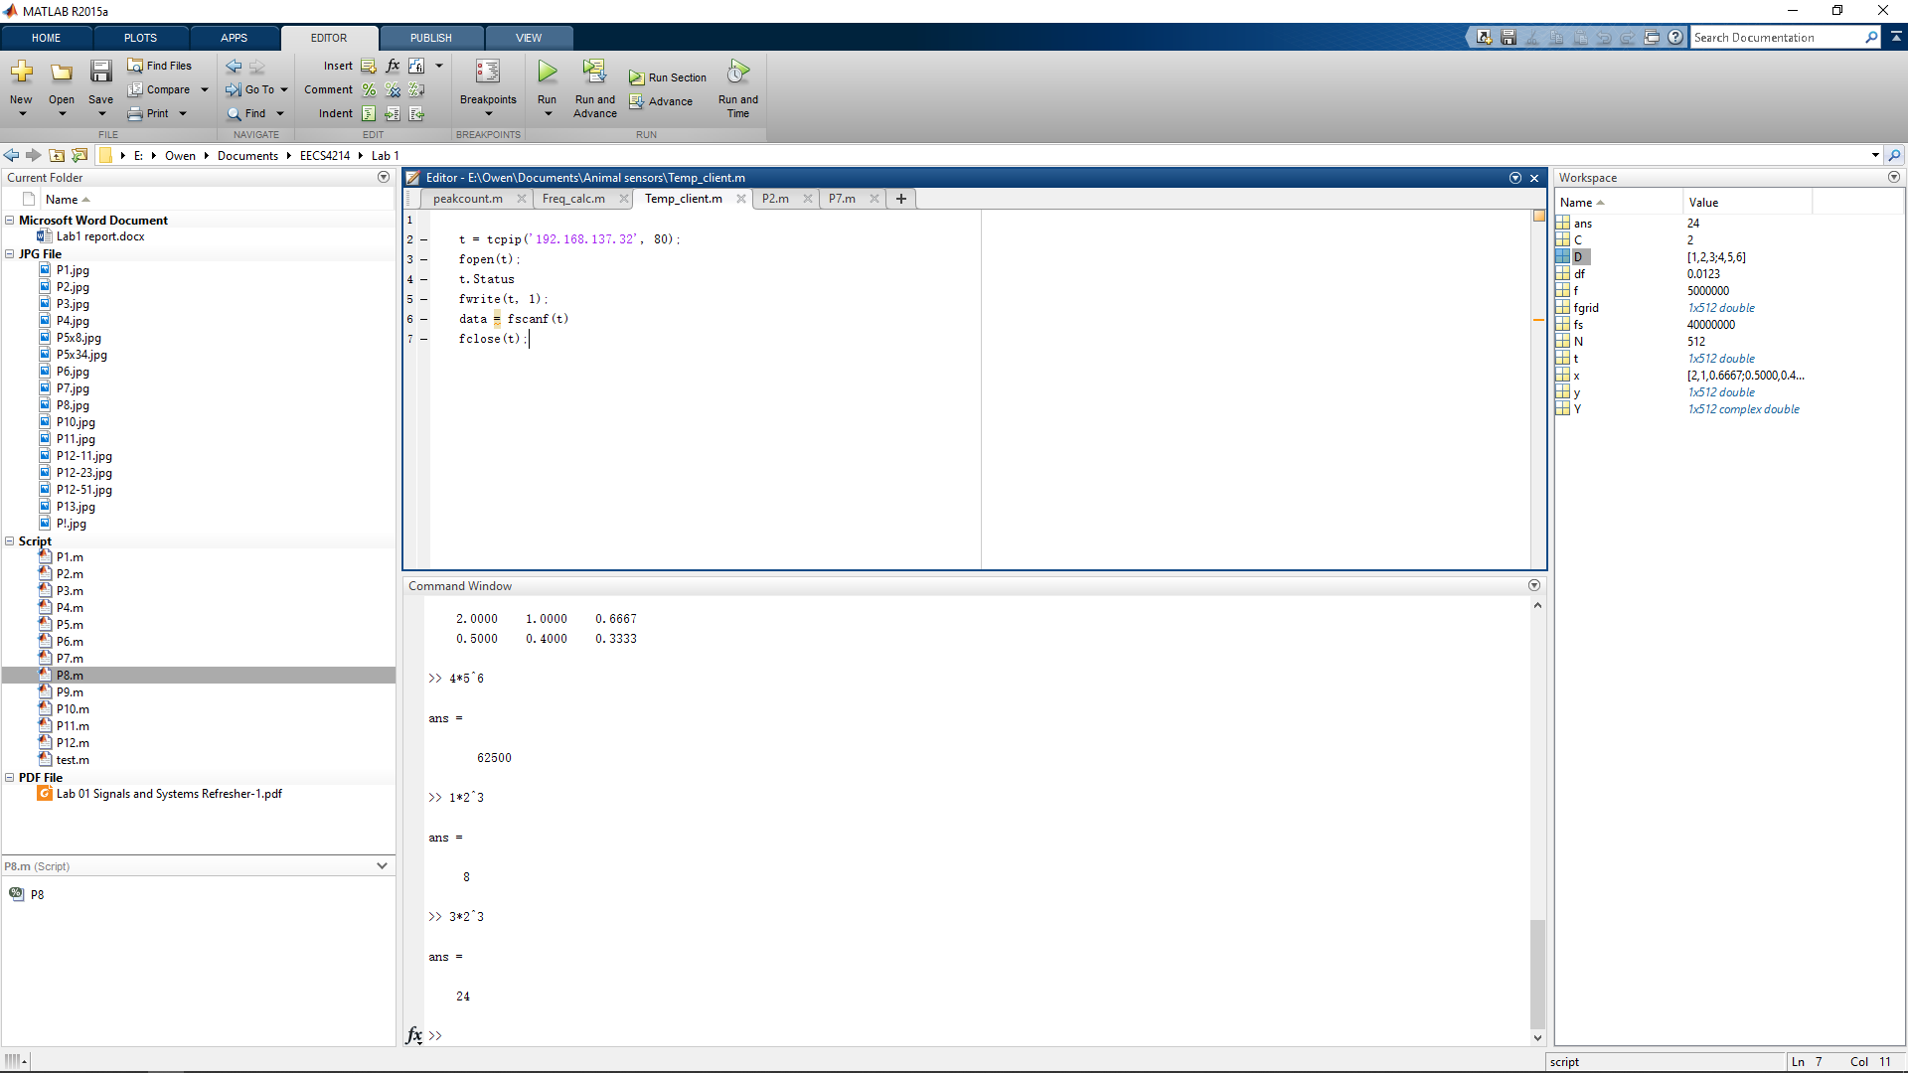
Interface
Control panel;
Code editor;
Command line;
Workspace directory;
Variables;

Slide 4

Operators
Arithmetic operators
+, -, *(multiplication), /(division), ^(power)
Relational operators
==(is equal),~=(is not equal),>,>=,<,<=
>> 1 == 2
ans = 0
They return 0 for false 1 for true

Slide 5


Variables
Specifically creating vectors and matrixes
X = [1 2 3] X = [1,2,3] X = [1:3] X = [1:1:3] linspace(1,3,3)
X = [1,2,3;4,5,6]
X = [1 2 3];
Y = [4 5 6];
Z = [X;Y]

Slide 6
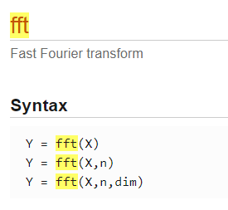
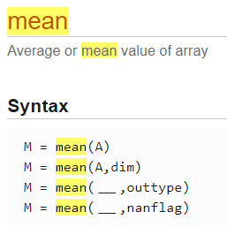
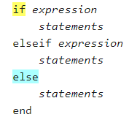

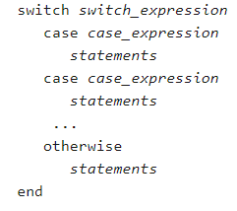

Functions and flow control
Output variables
Input variables
Function name
Function
Signatures

Slide 7
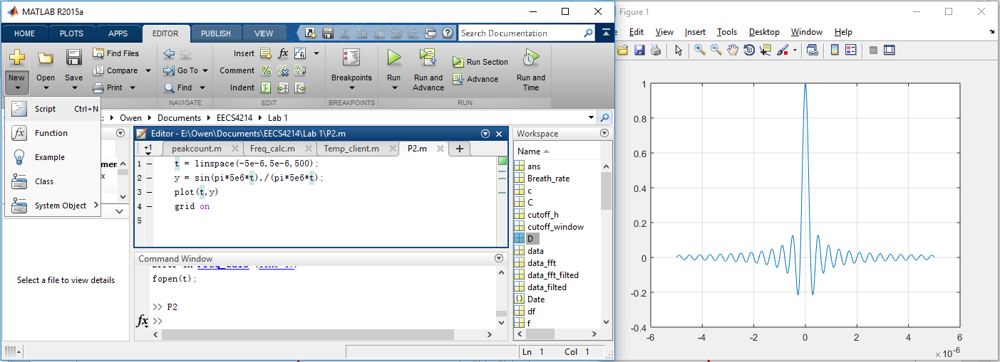
Creating Scripts and Functions
File creation; Code editor; Script execution; Script output;

Slide 8
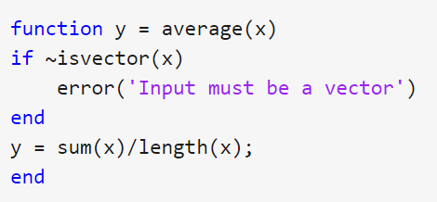

Creating Scripts and Functions
Define a function
Function
Signature
Function
Body
end key word = “}” in other languages
Using a function(either in cmd or a script)

Slide 9


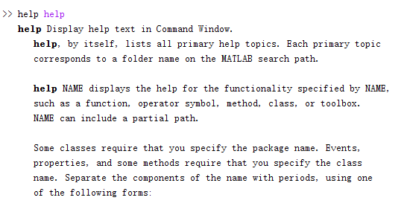
Let us be honest here….

Slide 10
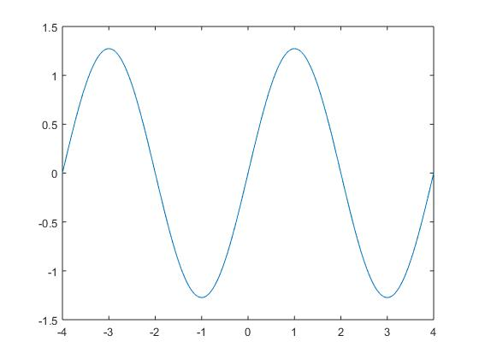
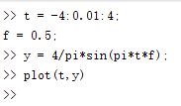

Some practice?
For: -4<=t<=4, f = 0.5
1) plot: $y\left(x\right)= \frac{4}{π}\sin\left(2πft\right)$

Slide 11
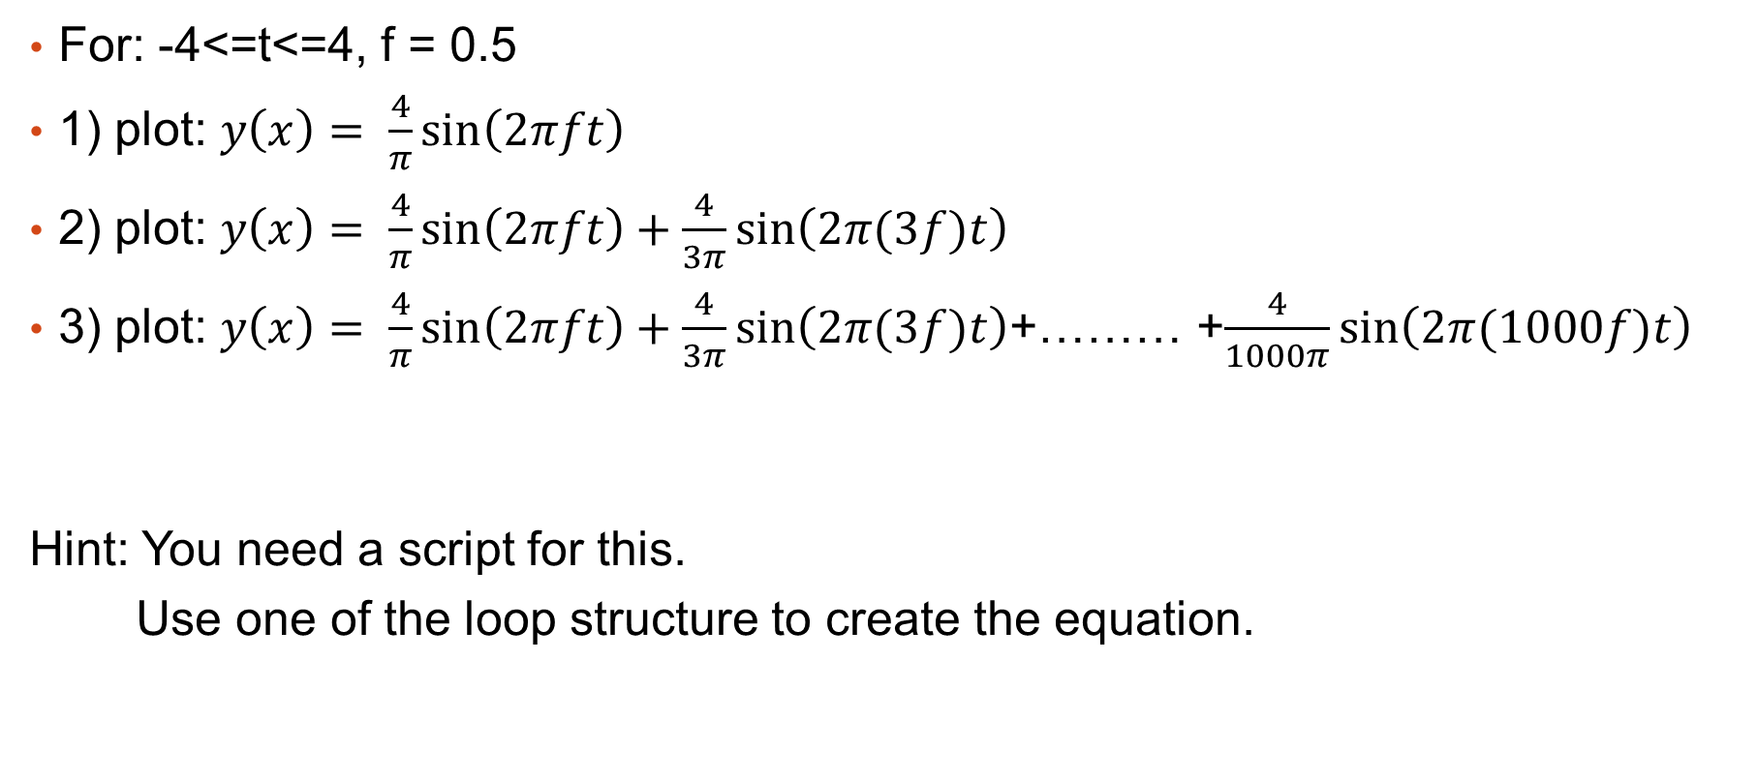
Some practice?
For: -4<=t<=4, f = 0.5
1) plot: $y\left(x\right)= \frac{4}{π}\sin\left(2πft\right)$
2) plot: $y\left(x\right)= \frac{4}{π}\sin\left(2πft\right)+\frac{4}{3π}\sin\left(2π(3f)t\right)$
3) plot: $y\left(x\right)= \frac{4}{π}\sin\left(2πft\right)+\frac{4}{3π}\sin\left(2π(3f)t\right)$+……… +$\frac{4}{1000π}\sin\left(2π(1000f)t\right)$
Hint: You need a script for this.
Use one of the loop structure to create the equation.

Slide 12
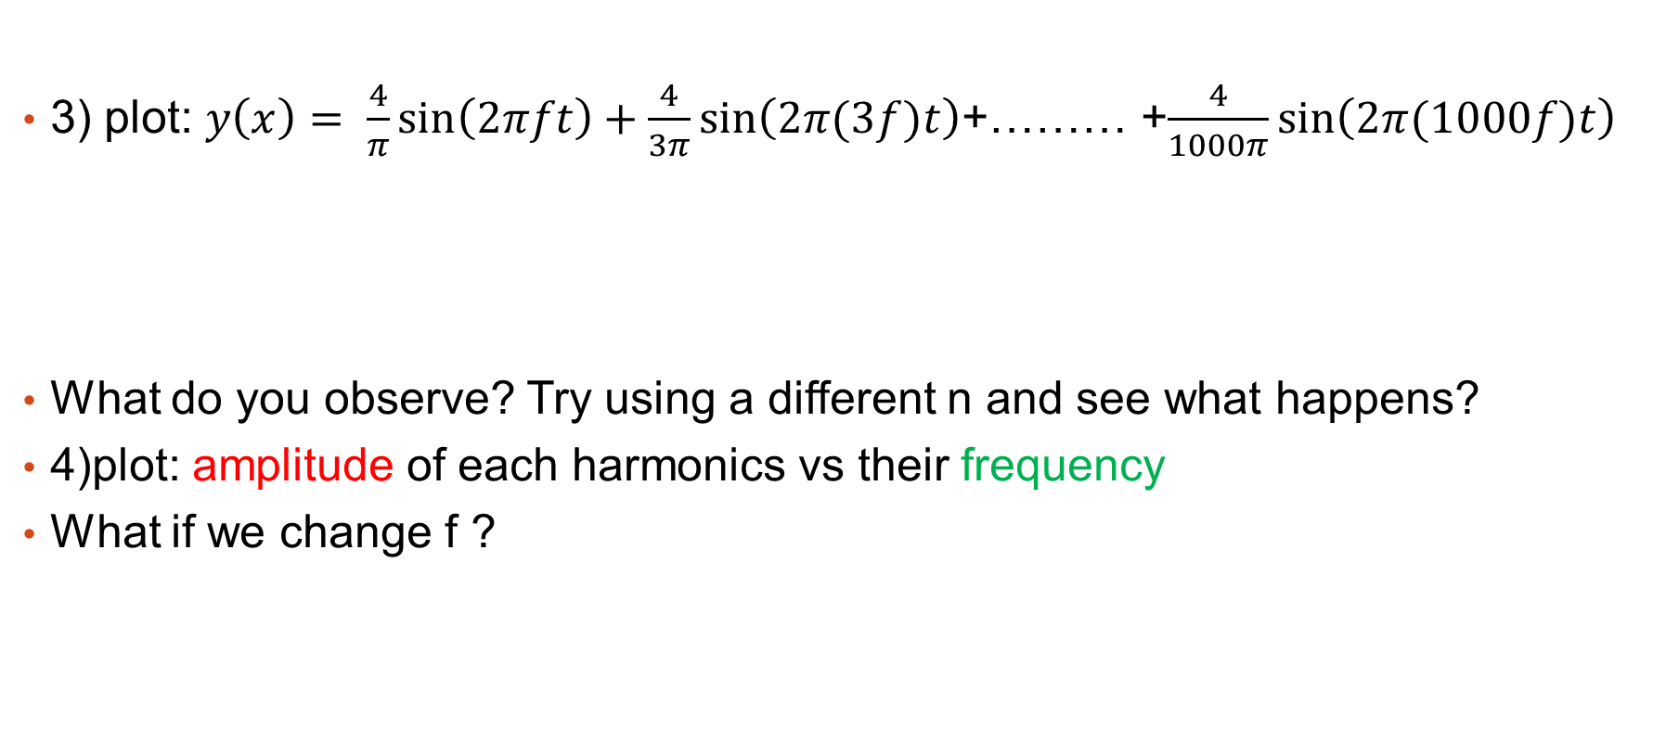
Some practice?
3) plot: $y\left(x\right)= \frac{4}{π}\sin\left(2πft\right)+\frac{4}{3π}\sin\left(2π(3f)t\right)$+……… +$\frac{4}{1000π}\sin\left(2π(1000f)t\right)$
What do you observe? Try using a different n and see what happens?
4)plot: amplitude of each harmonics vs their frequency
What if we change f ?
1f
3f
1000f

Slide 13

Thank you for your support.
Here’s a meme as your reward.

